Slide 1
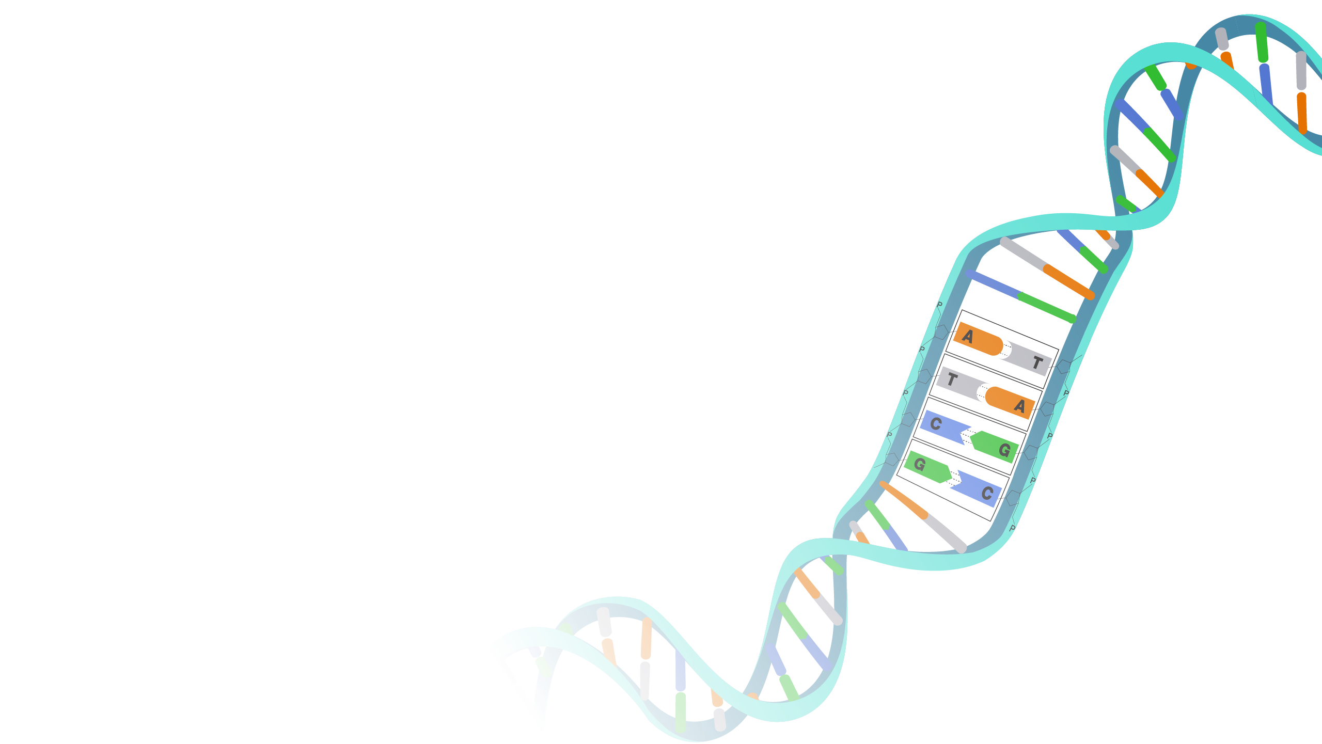
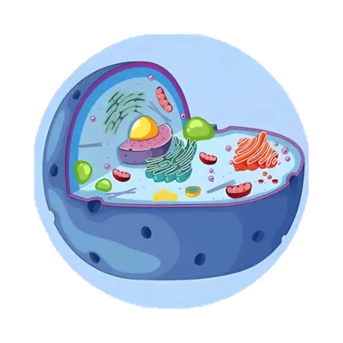
An Introduction to
Single-Cell
RNA Sequencing Data
The Human Cell Atlas
Mozhgan Orujlu

Slide 2
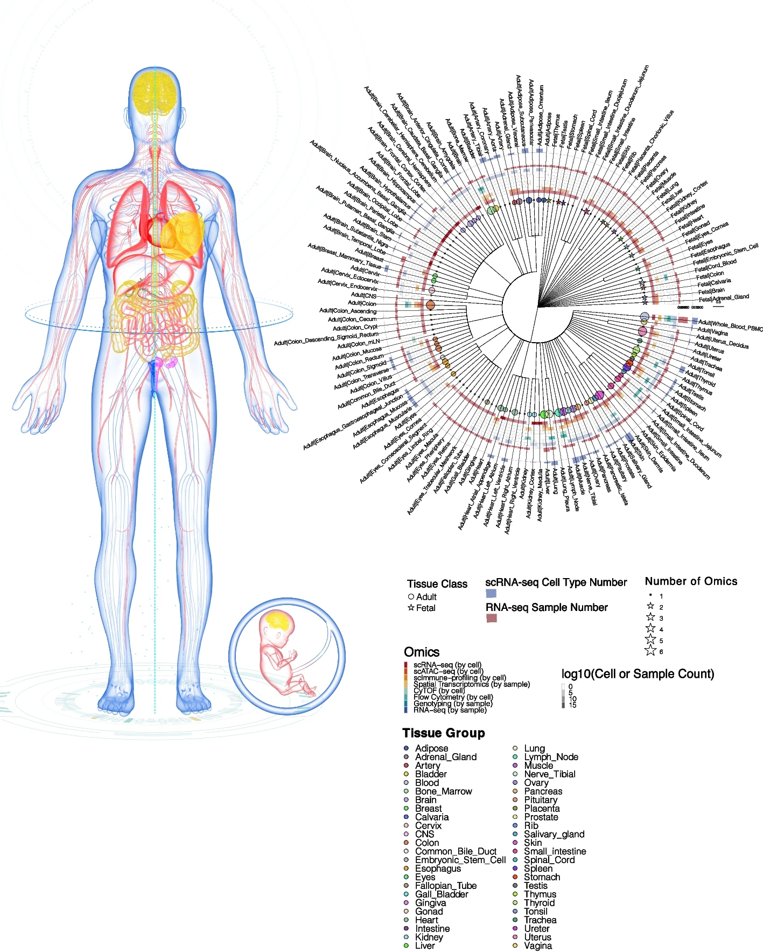
The Human
Cell Alas
Image from: Single Cell Atlas: a single-cell multi-omics human cell encyclopedia

Slide 3


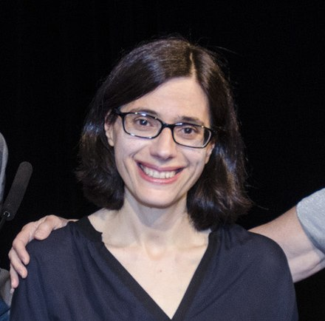
The White Paper
Sarah Amalia Teichmann
Aviv Regev

Slide 4
The Human
Cell Alas
The Human Cell Atlas (HCA) will be made up of comprehensive reference maps of all human cells — the fundamental units of life — as a basis for understanding fundamental human biological processes and diagnosing, monitoring, and treating disease.
It will help scientists understand how genetic variations impact disease risk, define drug toxicities, discover better therapies, and advance regenerative medicine.
As of 2024, the project has mapped approximately 62 million human cells into 18 biological networks, which includes cells from vital systems such as the nervous system, lungs, heart, intestine and immune system.

Slide 5
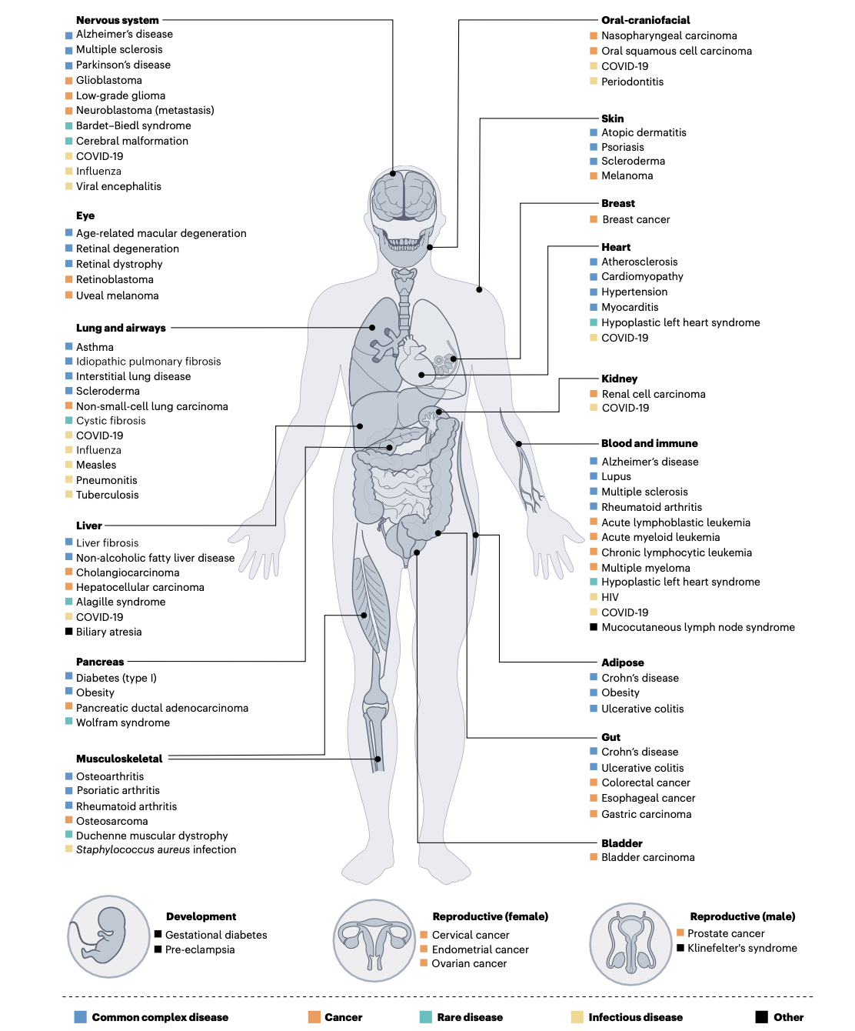
The Human
Cell Alas
Image from: Impact of the Human Cell Atlas on medicine
Sarah A. Teichmann & Aviv Regev

Slide 6
Key
Experimental
Methods
Key experimental methods for construction of cell atlases at different levels of biological organization
Clinical data
Tissue imaging and histology
Spatial
Multimodal
Transcriptomics
Genome and epigenomics

Slide 7
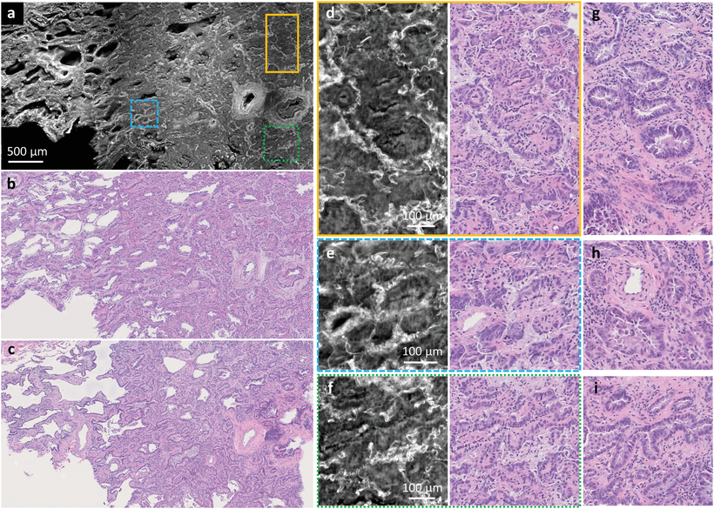
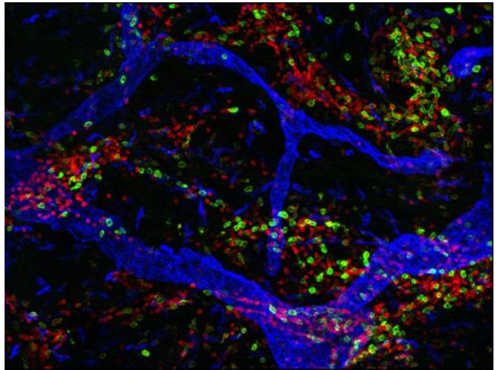
Key
Experimental
Methods
Key experimental methods for construction of cell atlases at different levels of biological organization
Clinical data
health-related information collected from patients, including medical history, laboratory test results, lifestyle factors, and clinical diagnoses.
Tissue imaging and histology
visualize tissue architecture and cellular organization and provides spatial context by revealing how cells are arranged within tissues by staining tissue sections and examining them under a microscope
It helps map cell types and their interactions within tissues
Example: Photoacoustic imaging,
Atomic force microscopy (AFC)
Image from: the white paper
Image from: High‐Throughput, Label‐Free and Slide‐Free Histological Imaging by Computational Microscopy and Unsupervised Learning

Slide 8
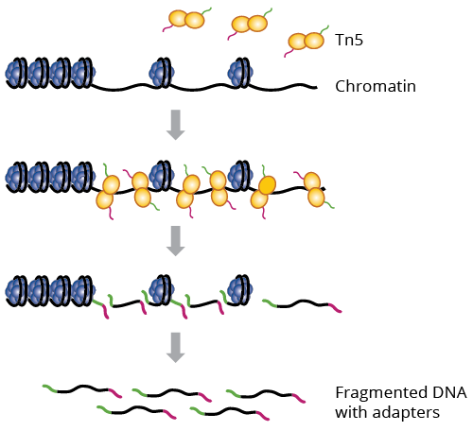
Key
Experimental
Methods
Spatial
Allows researchers to see where specific genes are active within the tissue, providing insights into the cellular environment.
Example: FISH , INSTA-seq
Genome and epigenomics
Techniques that study the genetic makeup (genome)
and chemical modifications to DNA and histones (epigenomics)
that regulate gene expression
Example: ATAC-seq
23 pairs of chromosomes (46 in total)
chr1 to chr22 (autosomes)
chrX, chrY (sex chromosomes).
chr1 3456000 3456500 peak1 120
chr2 7890000 7890500 peak2 230
chrX 1234500 1235000 peak3 190
Image from: www.genewiz.com

Slide 9
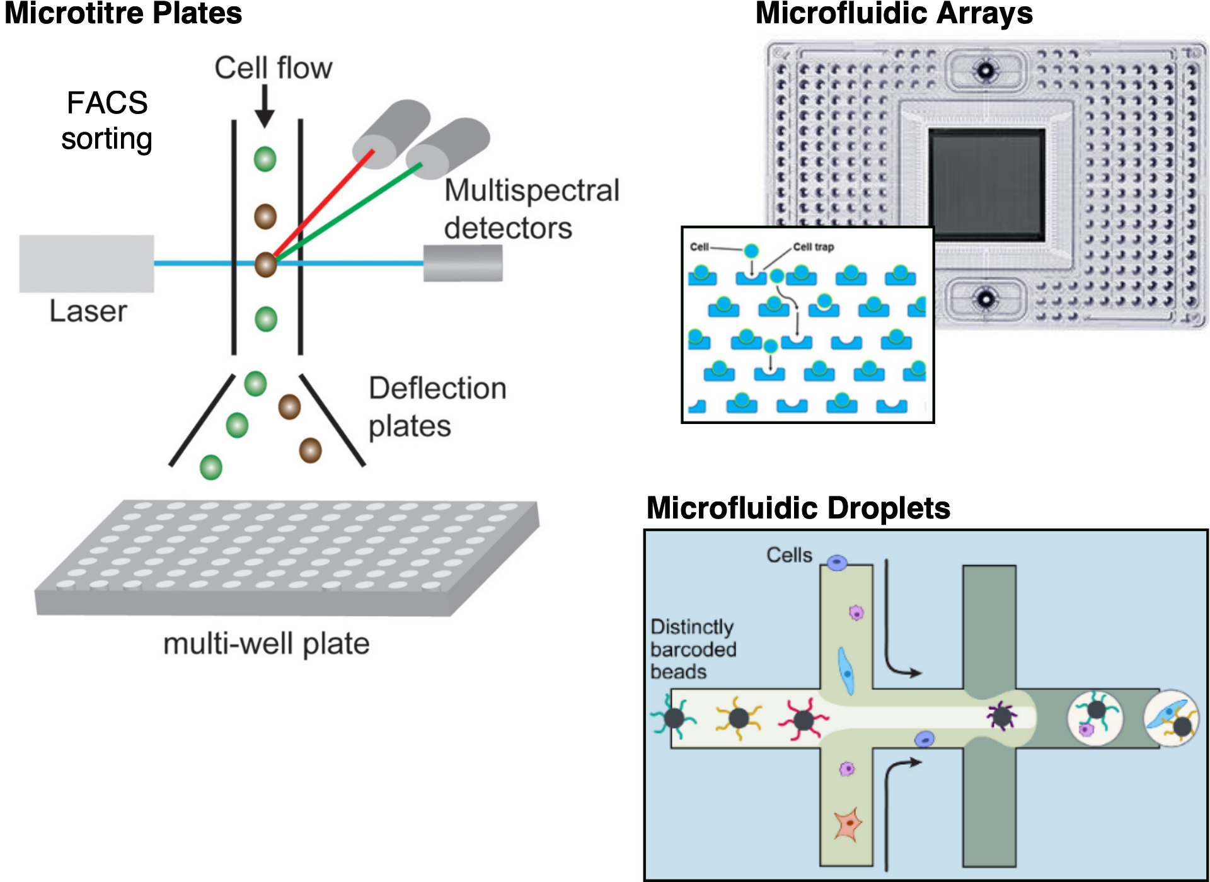
Key
Experimental
Methods
Transcriptomics
Purpose: To measure which genes are active (expressed) and how much they're expressed in cells.
Examples
scRNA-seq
MARS-seq
Smart-seq
Drop-seq
Seq-Well
Chromium
Multimodal
Combines multiple types of data, such as gene expression, protein levels, and chromatin accessibility, within the same cells
Example:
ASAP-seq
SHARE-seq

Slide 10
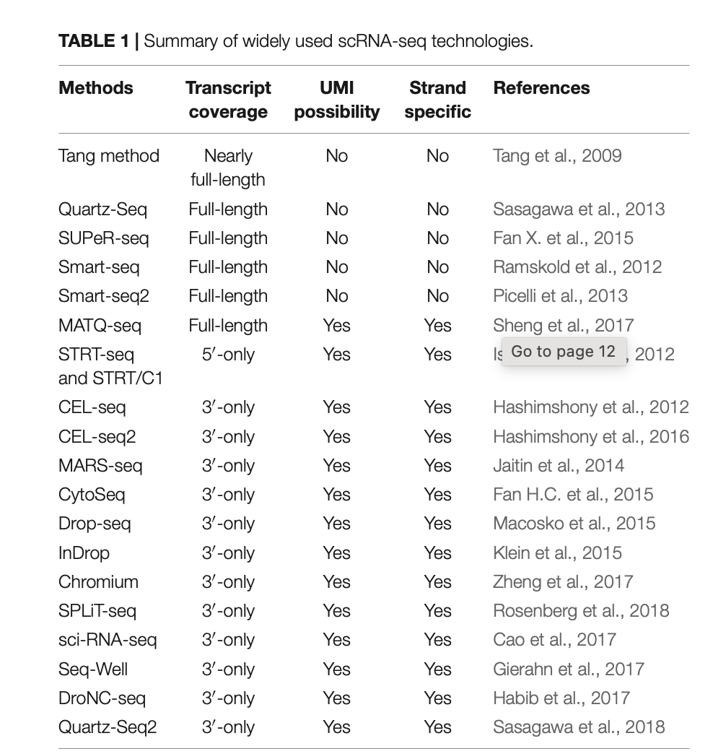
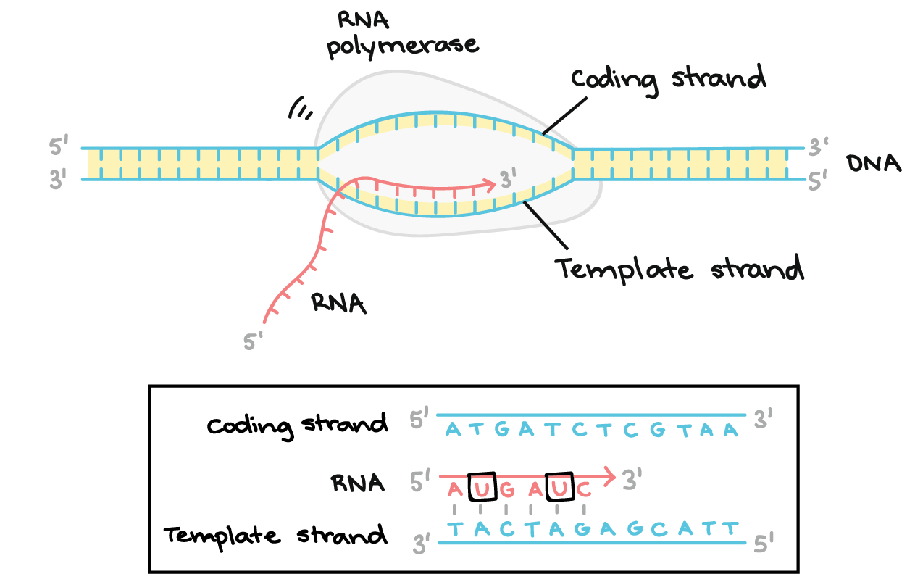
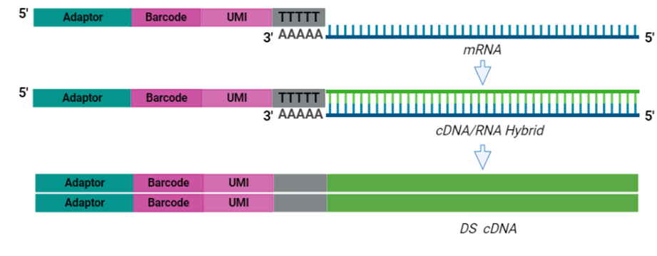
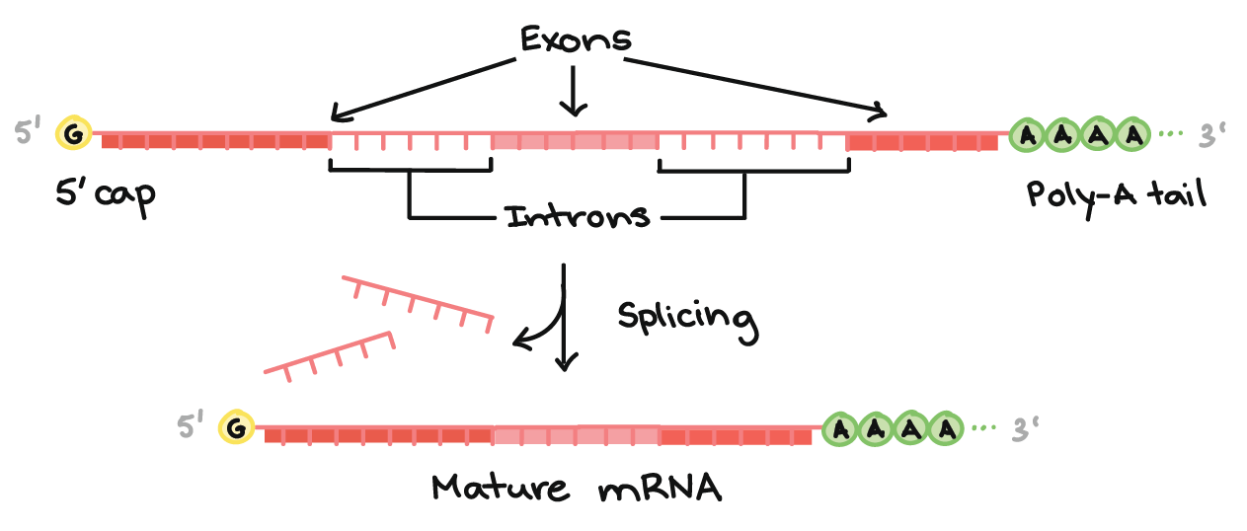
Key
Experimental
Methods

Slide 11
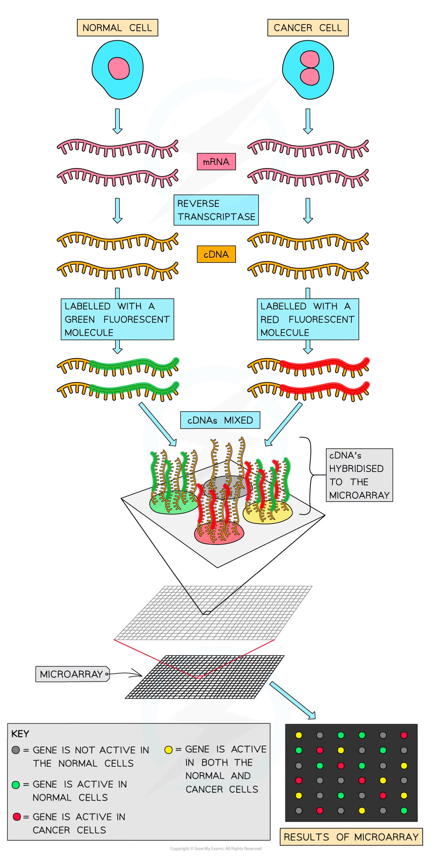
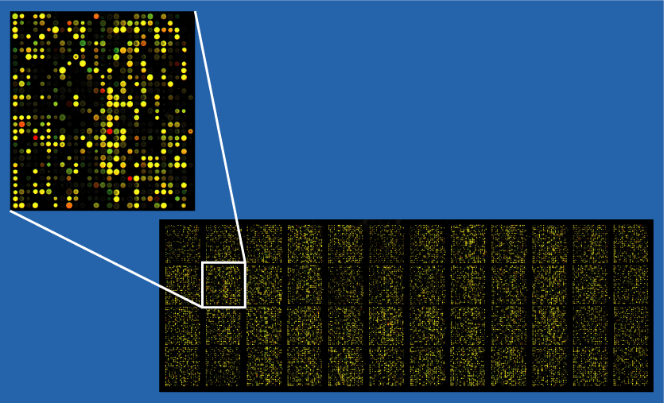
Microarrays
Microarrays (DNA chip)
a high-throughput technology that allows
researchers to study the expression levels
of many genes or to detect genetic variations
in a single experiment. It consists of a solid surface
(e.g., a glass slide or silicon chip) with thousands
of microscopic spots, each containing a specific DNA,
RNA, or protein sequence.

Slide 12
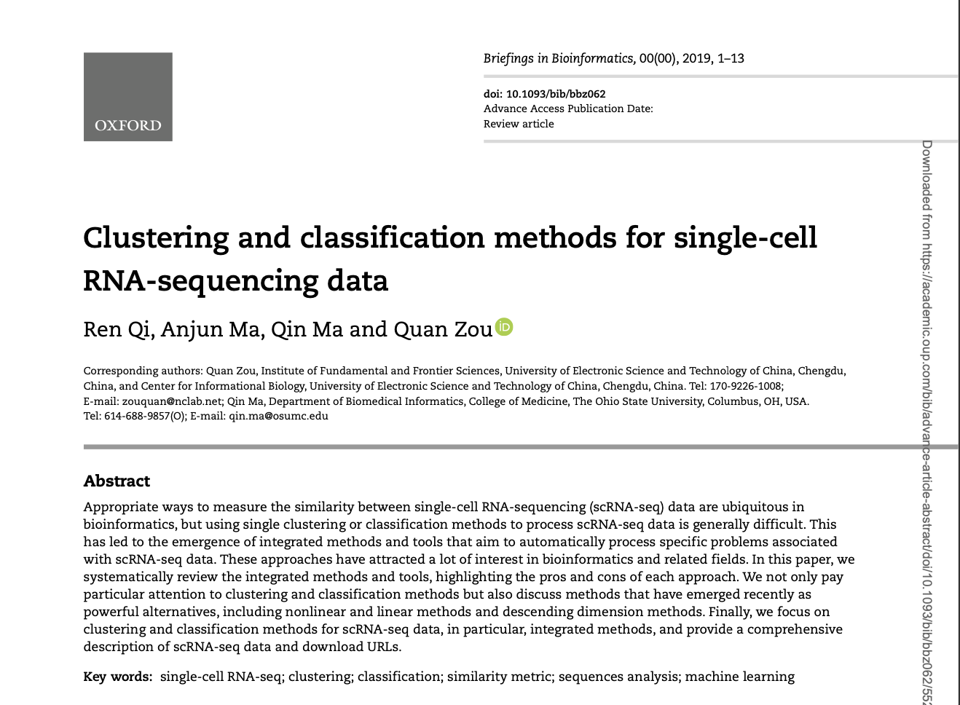
Clustering

Slide 13
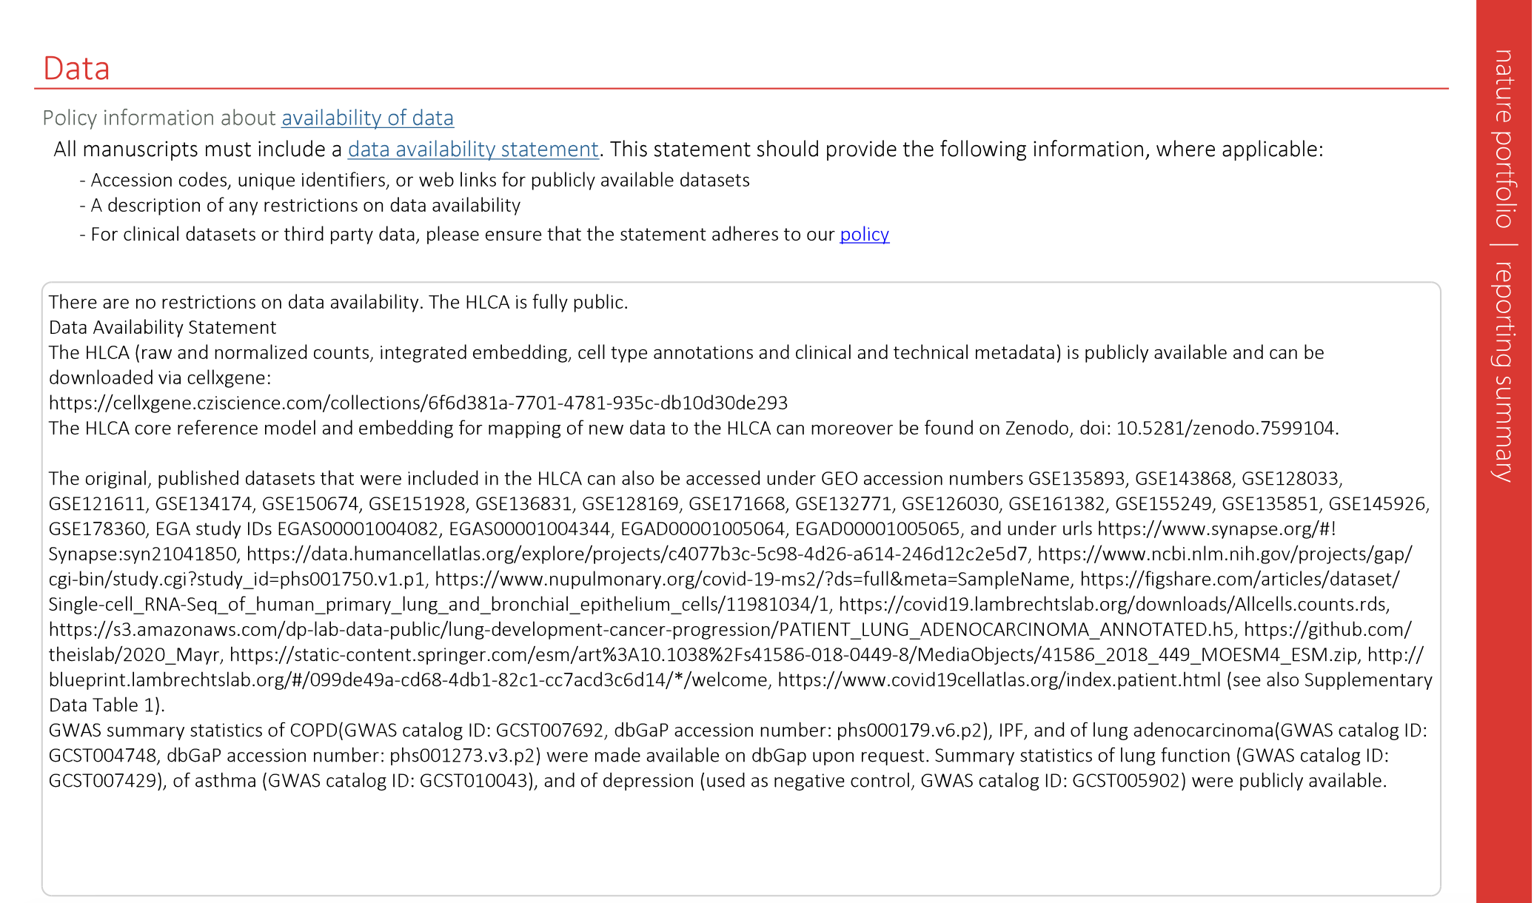
Data Availability

Slide 14
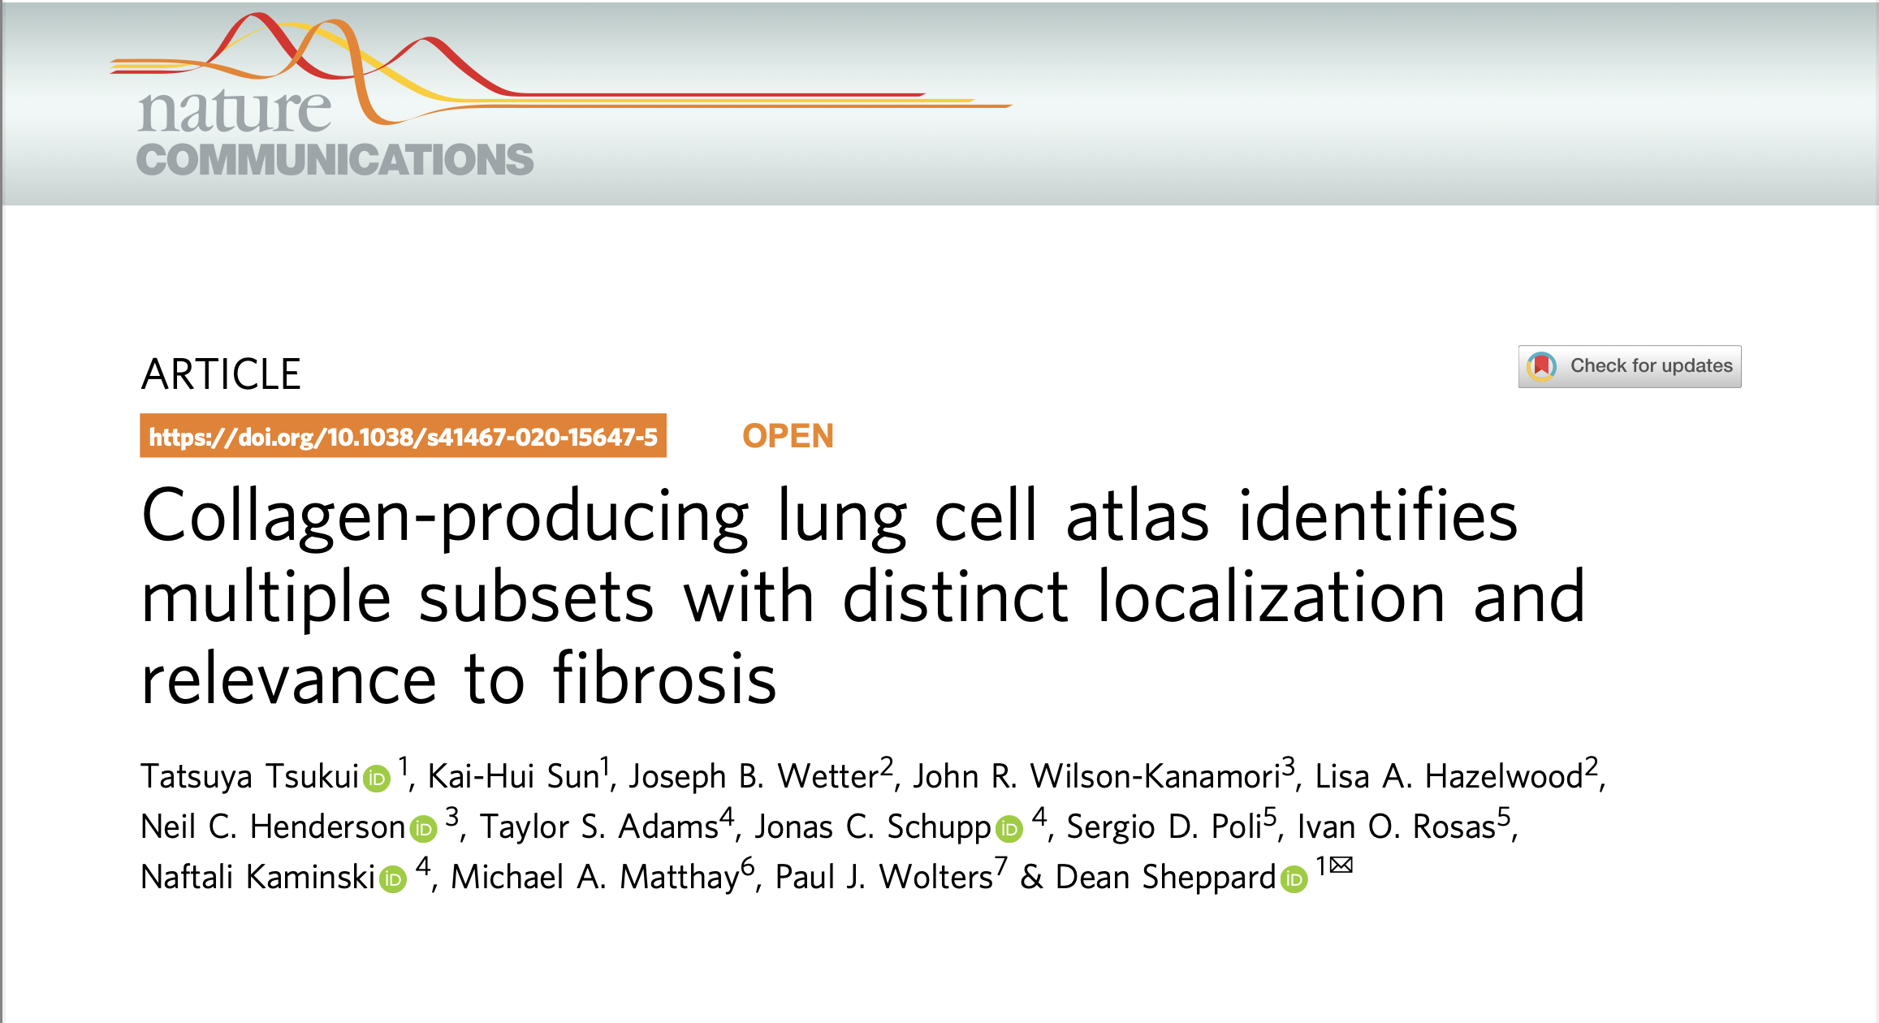

Slide 15
Quality
Control
Three main key factors : QC covariates
Count depth
Low count depth ➡️ damaged or broken cells
Very high count depth ➡️ doublets
Threshold ➡️ 500, 20,000
The number of genes per barcode
Low ➡️ dead cells or empty droplets
Very high ➡️ doublets
The fraction of counts from mitochondrial genes per barcode
Very high ➡️ dying or stressed cells, broken cells
A normal mitochondrial fraction for a healthy cell is typically less than 5–10%

Slide 16
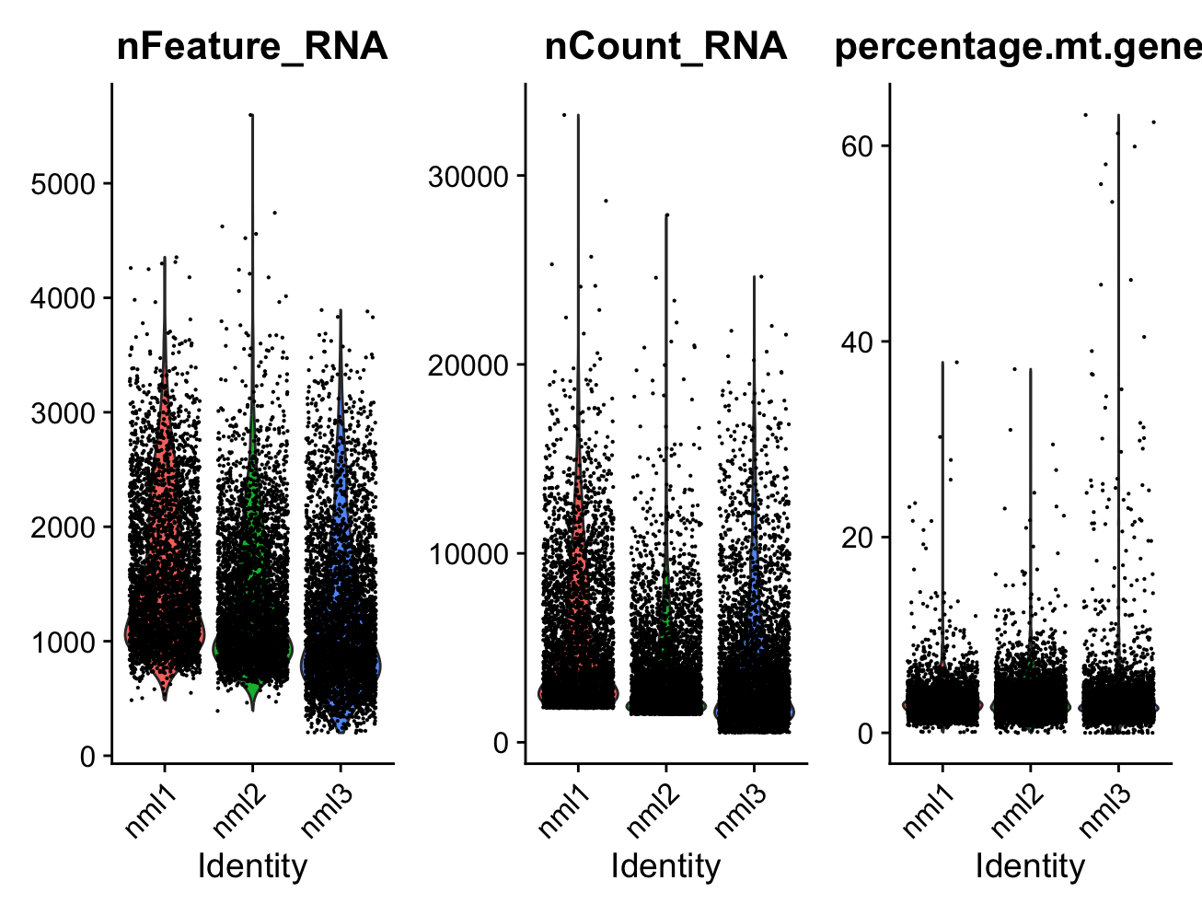
Before quality control

Slide 17
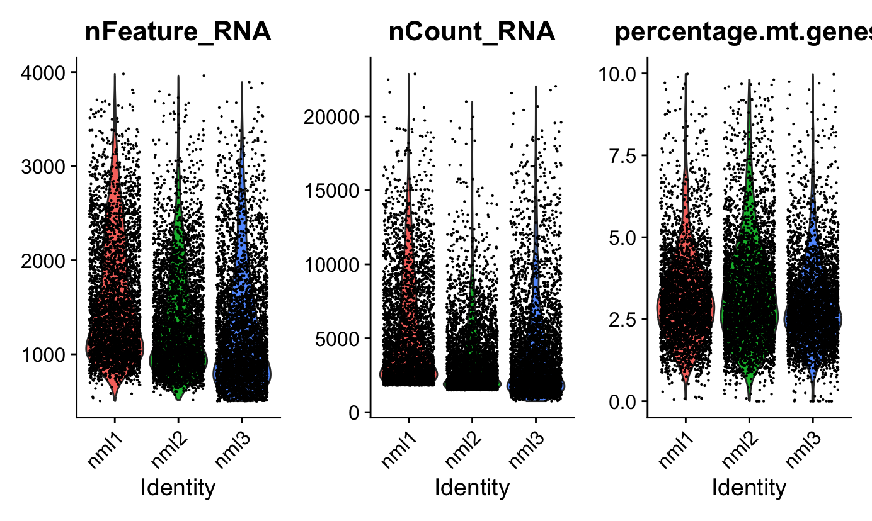
after
Quality control

Slide 18
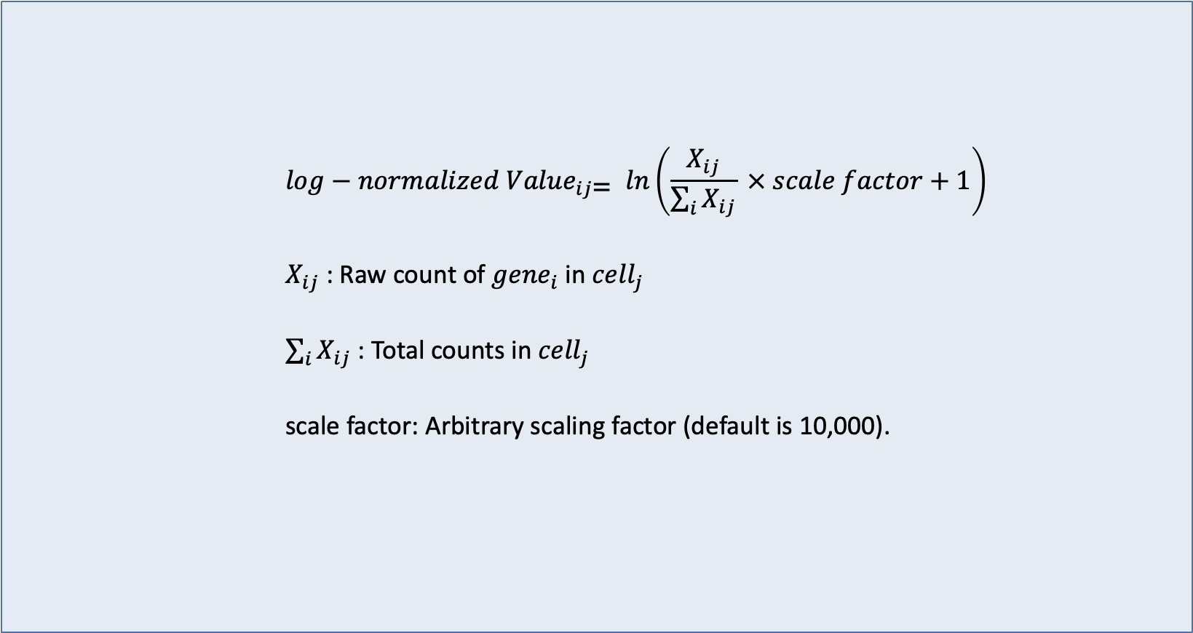
Normalization
$$log−normalized {Value}_{ij\text{=}} ln\left(\frac{X_{ij}}{\sum_{i}{X_{ij}}} × scale factor+1\right)$$
$X_{ij}$ : Raw count of ${gene}_{i}$in ${cell}_{j}$
$\sum_{i}{X_{ij}}$ : Total counts in ${cell}_{j}$
scale factor: Arbitrary scaling factor (default is 10,000).

Slide 19
Find
Variable
Features
The goal of FindVariableFeatures() is to identify genes whose expression varies significantly across cells.
hese genes are often biologically meaningful, as they may represent cell-type-specific markers or genes involved in dynamic processes like differentiation.
For each gene, the mean expression level across all cells is calculated.
The variance of each gene's expression across all cells is also calculated.
In single-cell RNA-seq data, there is typically a strong relationship between a gene’s mean expression and its variance.
Genes with higher mean expression tend to have higher variance.

Slide 20
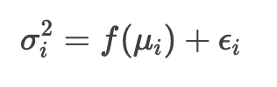
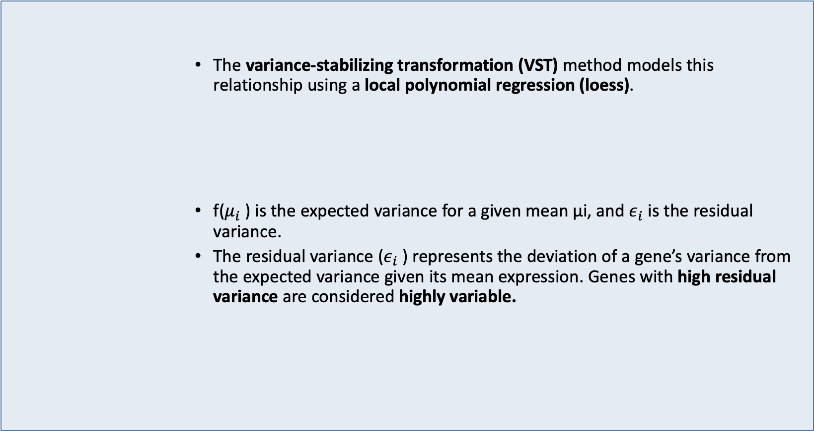
Find
Variable
Features
The variance-stabilizing transformation (VST) method models this relationship using a local polynomial regression (loess).
f($μ_{i}$) is the expected variance for a given mean μi, and $ε_{i}$is the residual variance.
The residual variance ($ε_{i}$) represents the deviation of a gene’s variance from the expected variance given its mean expression. Genes with high residual variance are considered highly variable.

Slide 21
Find
Variable
Features
Seurat uses a local polynomial regression (loess) to fit a smooth curve to the observed mean-variance relationship.
The loess model is a non-parametric method that fits a smooth curve to the data by performing weighted linear regression in local neighborhoods. It is robust to outliers and adapts well to the shape of the data.

Slide 22
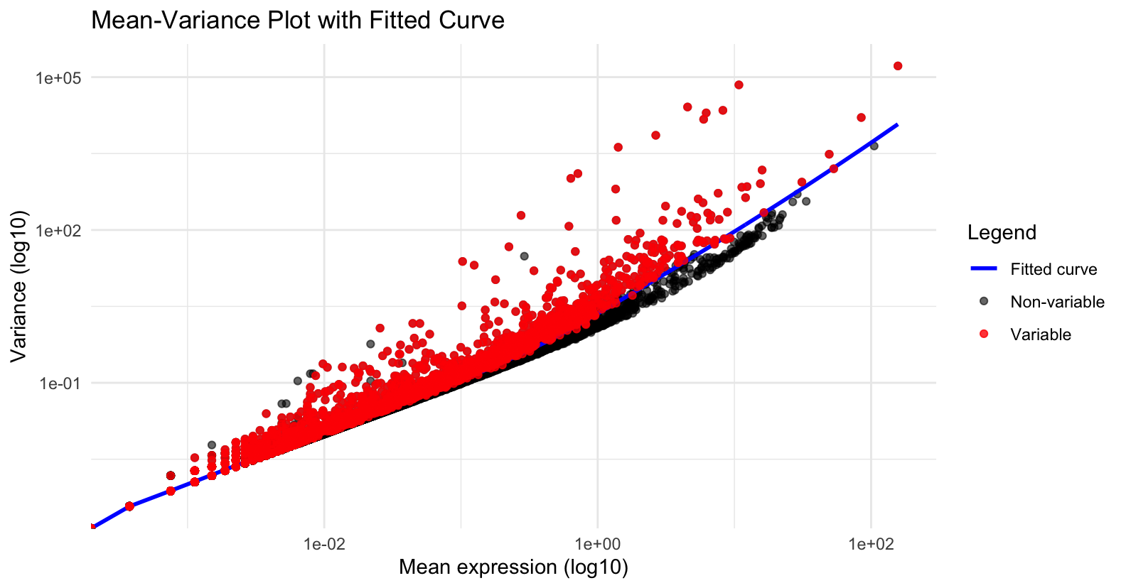
Find
Variable
Features

Slide 23
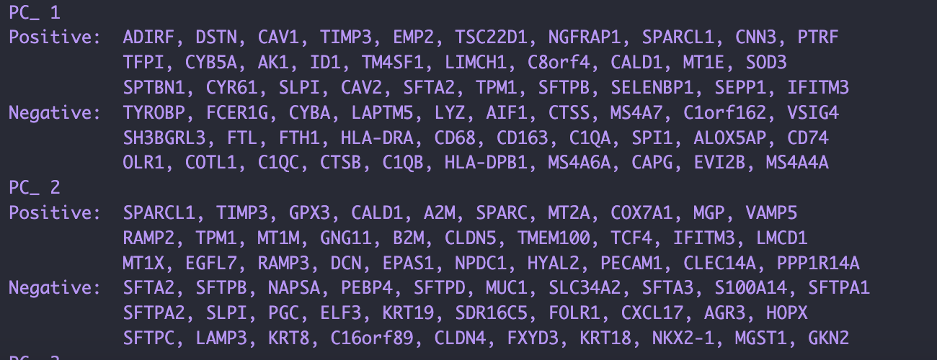
PCA

Slide 24
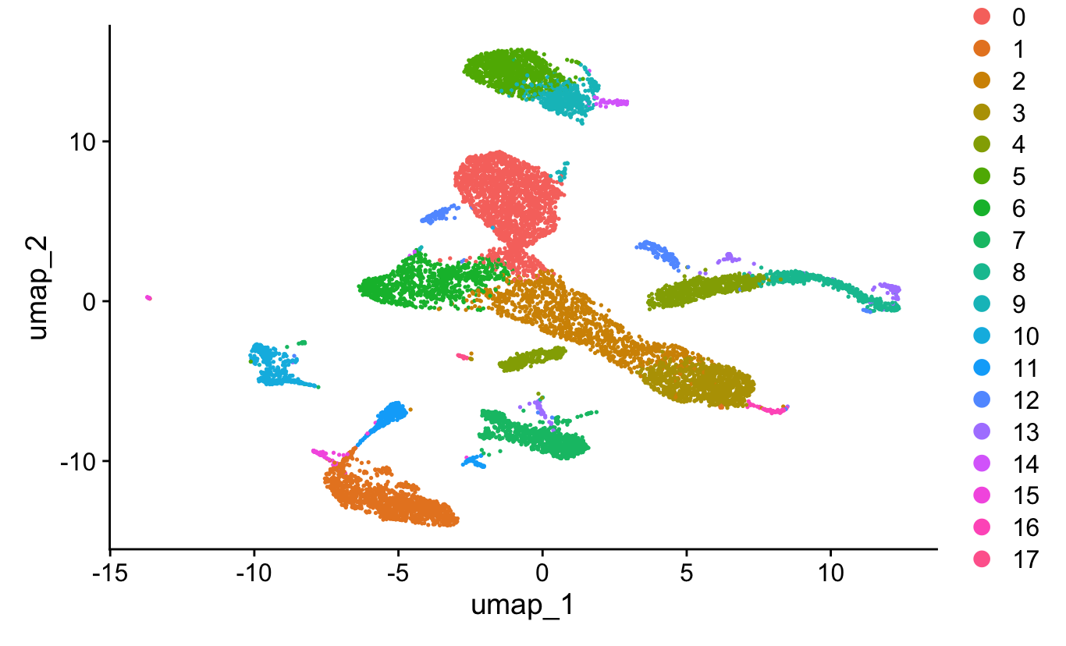
Clusters
Resolution:0.5

Slide 25
Next session

